Slide 1

Bias Variance Trade-off Overfitting and Underfitting
Machine Learning

Slide 2
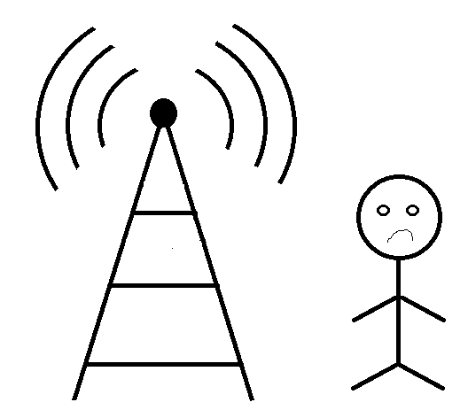
Let us take a simple analogy to get started: I’ll give you three choices:
1. Stay very close to a mobile cell tower to get the maximum possible internet speed but then get exposed to high radiation and the severe health implications.

Slide 3
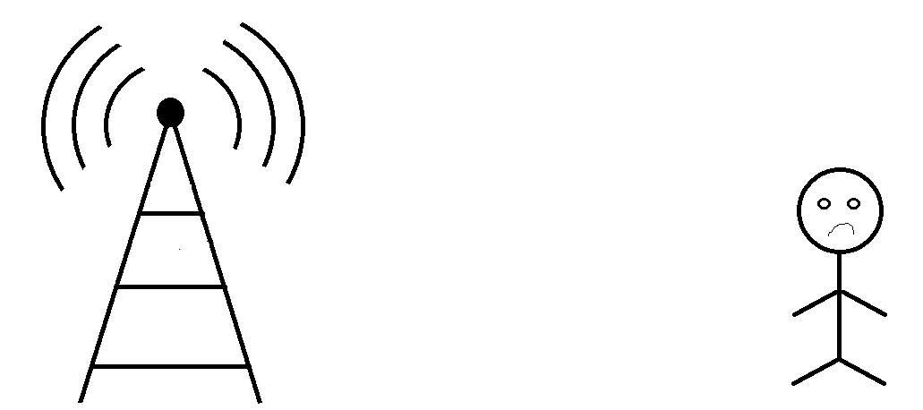
2. Stay very faaaaar away from a mobile cell tower for health reasons but get a tortoise-like (no offence to the turtle community btw) internet speed.

Slide 4
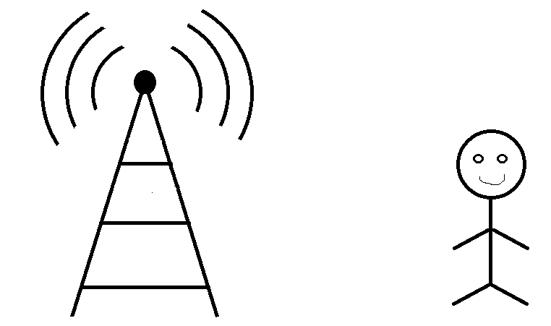
3. Stay at a decent distance away from a mobile cell tower, making peace with a slightly slower internet speed, while getting medium to low exposure to the radiations, and hence live a healthy life.

Slide 5
Bias and Variance
Plague all of supervised Machine Learning
High presence of either bias or variance results in overfitting or underfitting and can put the brakes on the capabilities of our machine learning model and render it not so useful.
We cannot force either of them out of our model, but we can try and possibly minimize their effects to achieve a stable model.

Slide 6
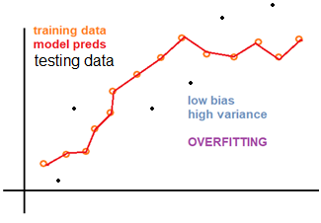
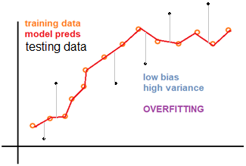
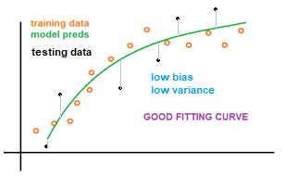
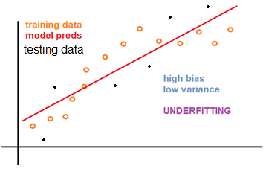
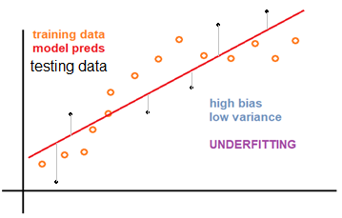
Bias is calculated on training data | Variance is calculated on testing data
→ Bias is sum of squared differences of actual (train data) and predicted values
→ Variance is a measure of how the predicted line would work on unseen (test) data
----------------------------------------------------------------------------

Slide 7
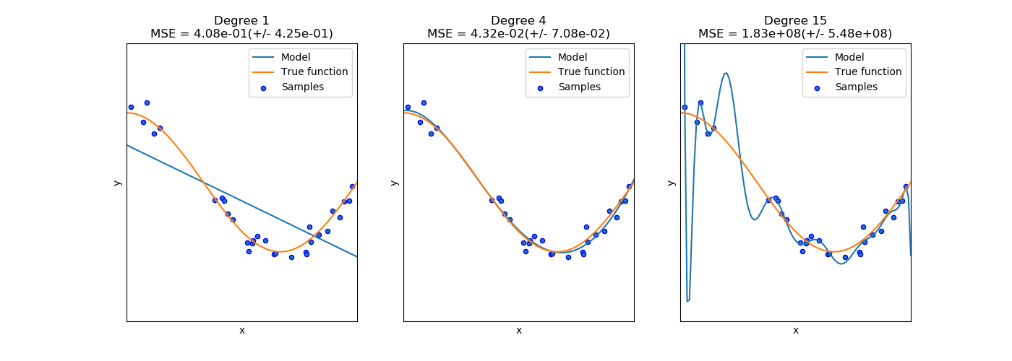
Just in case you don’t believe whatever I’ve said until now (if you really don’t, please let me know in the comments section below ☺), let’s discuss these plots taken from official sklearn website!
The MSE is calculated on the validation (test) set. The higher it is, the less likely the model generalizes correctly from the training data.
Naughty kid, doesn’t even know
there’s an exam. Somehow guesses/ copies his way to average marks in the test
Attentive kid, understands a concept thoroughly.
Gets very good marks in the test!
Mug-up kid, does very well on the solved examples in
class, but fails miserably on
the new questions in the test
https://scikit-learn.org/stable/auto_examples/model_selection/plot_underfitting_overfitting.html#sphx-glr-auto-examples-model-selection-plot-underfitting-overfitting-py

Slide 8
How to detect overfitting and underfitting you ask?
If a model performs excellently well on the training data (for ex. over 90-95%), but fails miserably on the testing data (for ex. around 60-65%) – OVERFITTING
If a model performs poorly on both training and testing data, (for ex. 65% and 60% respectively) – UNDERFITTING

Slide 9
If a model performs poorly on training data but excellently on testing data … BOOOOOM!
Unfortunately though, no. It is a sign of either data leakage into the test set, or that you had a relatively small test set to begin with, or maybe it is just through a random chance!
Just shuffle your dataset, increase the test set size and build the model again.
gif credit: tenor.com

Slide 10
So what is an ideal machine learning model you ask?
Low bias on the training data and low variance on the testing data.
If you have a model that fits nicely on the training data and at the same time generalizes onto the testing set equally well, you’ve hit the jackpot!
Bottomline: Just make sure you’re consistently making good predictions on the test set, which is a sign of good generalization.
gif credit: tenor.com

Slide 12
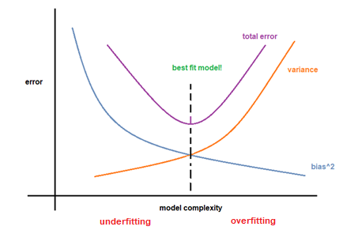
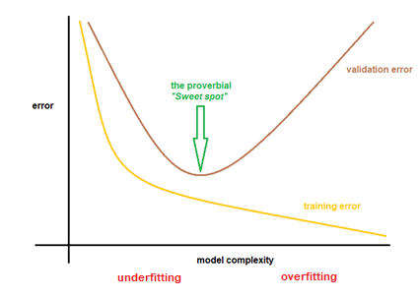
Total error = reducible error + irreducible error
(bias term & variance term) (inherent noise in the data, can’t be reduced)

Slide 13
Signal vs Noise
A toy house price dataset, trying to model the average house price in a neighborhood based on a few features.
All the five training data neighborhoods are from one city only.
Now, for a new neighborhood F, should we predict average house price for a new neighborhood in that city based on all of these features?
Umm… NO, right!
Spectacles, potholes and street dogs are “noise” features. The others are potentially “signal” features.

Slide 14
Some useful ways to avoid over fitting:
Train with more data (holistically)
Reduce the number of features
Reduce complexity of the model, using techniques like bagging, boosting, regularization etc.
Reduce noise in the data

Slide 15
Some useful ways to avoid under fitting:
Train with more data
Increase the number of features
Increase complexity of model using techniques like bagging, boosting, regularization etc.
Reduce noise in the data

Slide 16
Some useful ways to check for underfitting and overfitting:
Validation curves
Learning curves
Both are extremely powerful in diagnosing our results. We’ll look at them in depth in future videos.

Slide 17
That would be all for this tutorial
Thank you!
☺

